Slide 1

Electra.AI
The next-gen electricity savior

Slide 2
Optimizing Electricity Consumption through Machine Learning
Solution:
Forecasting usage of Electricity - Using Data Science to forecast electricity consumption for every month
Detecting Appliances consuming maximum Electricity - Find out heavy appliances which consume the maximum electricity
Smart Control of Appliances - Learning from daily usage and controlling usage of appliances/electrical devices based on time, weather conditions, presence of human being, etc.
Anomaly Detection for Faulty Devices - Generating anomalies in the daily consumption data when there is extra consumption by any appliance because of some glitch/shortage/fault in supply line
Early Warning for unusual Electricity consumption - Raise an early alert when the electricity consumption is abnormally high so that the customer becomes aware that the bill might be too high
Pain Points:
Electricity Bill - The electricity bill is a concern for the middle class people
Unnecessary usage of Appliances - Summers are unbearable without ACs but unnecessary usage will lead to high bill amount
Faulty/Old appliances – Certain appliances which are faulty or have become really old consume high amount of electricity

Slide 3

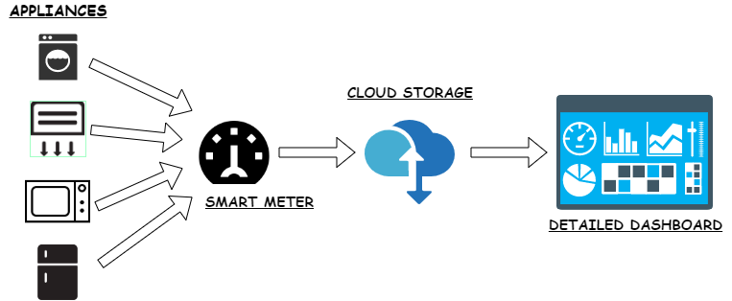
Architecture of Electra.AI

Slide 4

Features of Electra.AI
1) Detailed Dashboard – The detailed dashboard provided to the customer provides easy monitoring of the electricity consumption
2) Appliance-wise Consumption – Will help the user to understand which appliances are being used the most and hence contributing maximum to the billing amount. This way the user can try to minimize the usage of those particular appliances
3) Time-Series Forecasting & Early Warnings – Forecasting will help the user understand how much electricity is going to get consumed in the upcoming months and accordingly he can try to minimize it. Also, if there is abnormal usage of electricity it will generate early warnings so that the bill does not cross an excessive amount
4) Detection of Faulty Devices – Raise Anomalies in electricity consumption by any appliance. If there are too many anomalies then it means there is some kind of a shortage/faulty device which is leading to abnormal consumption of electricity

Slide 5

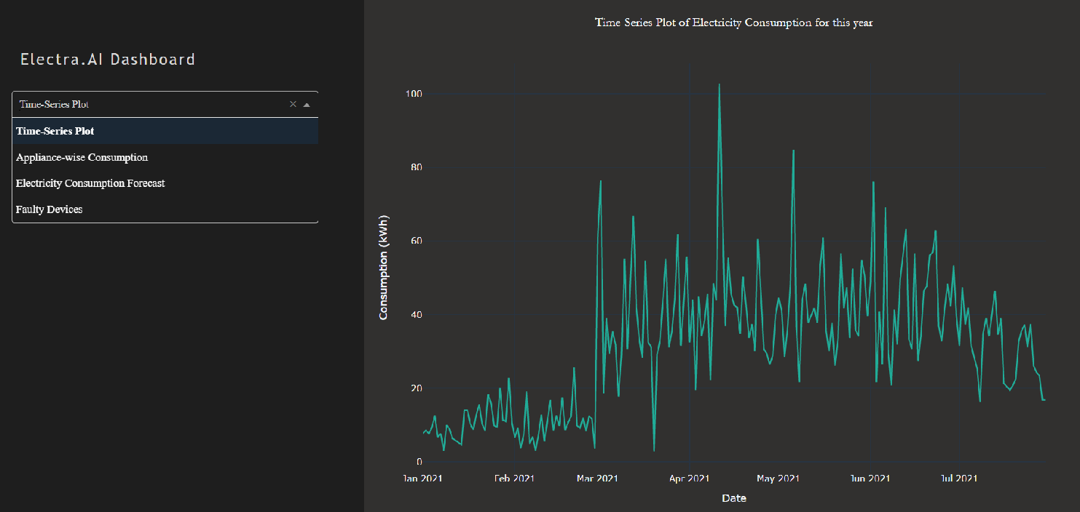
Detailed dashboard to keep a track of electricity consumption for easy monitoring
The Electra.AI dashboard provides a deep-insight to the consumer of the electricity consumption

Slide 6

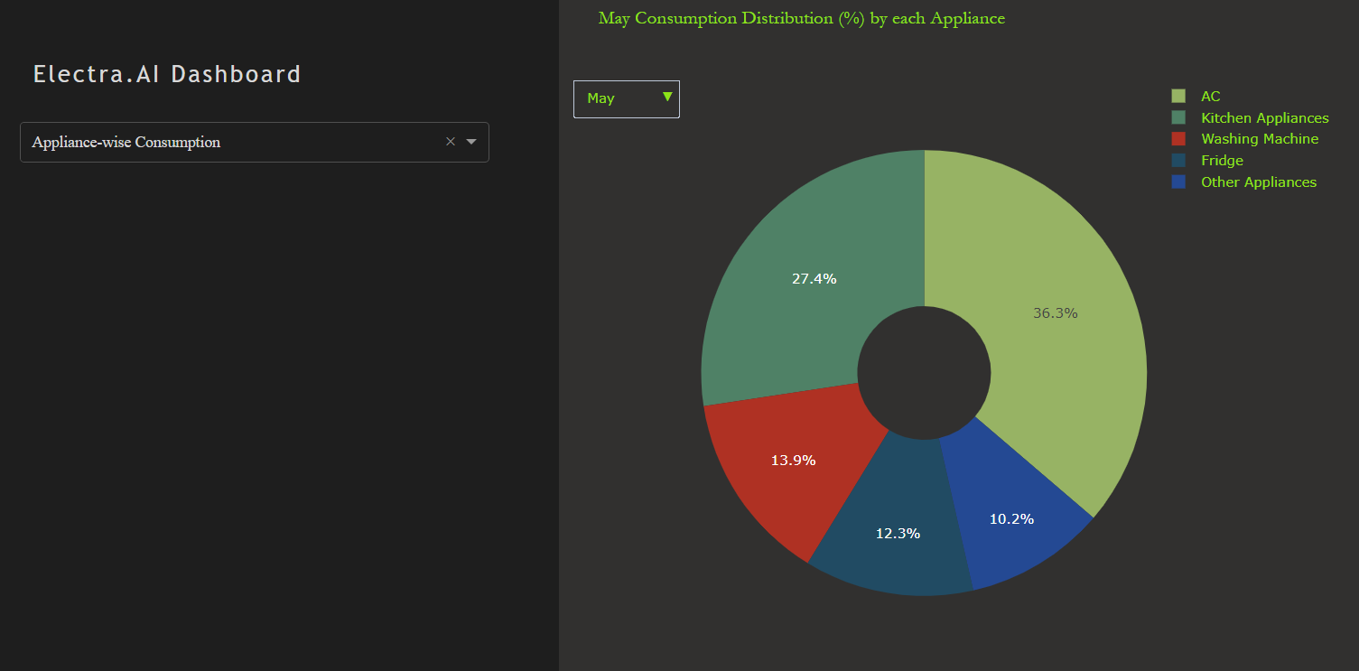
Appliance-wise Consumption for Consumer to optimize usage of specific Appliances
Finding the correct appliance usage to optimize - The distribution of appliance usage gives the consumer to accurately optimize the electricity consumption specific to that appliance

Slide 7

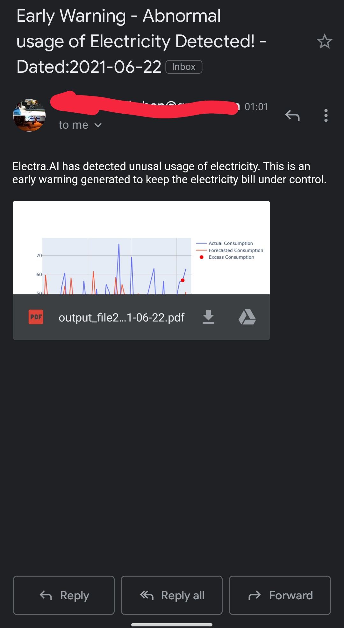
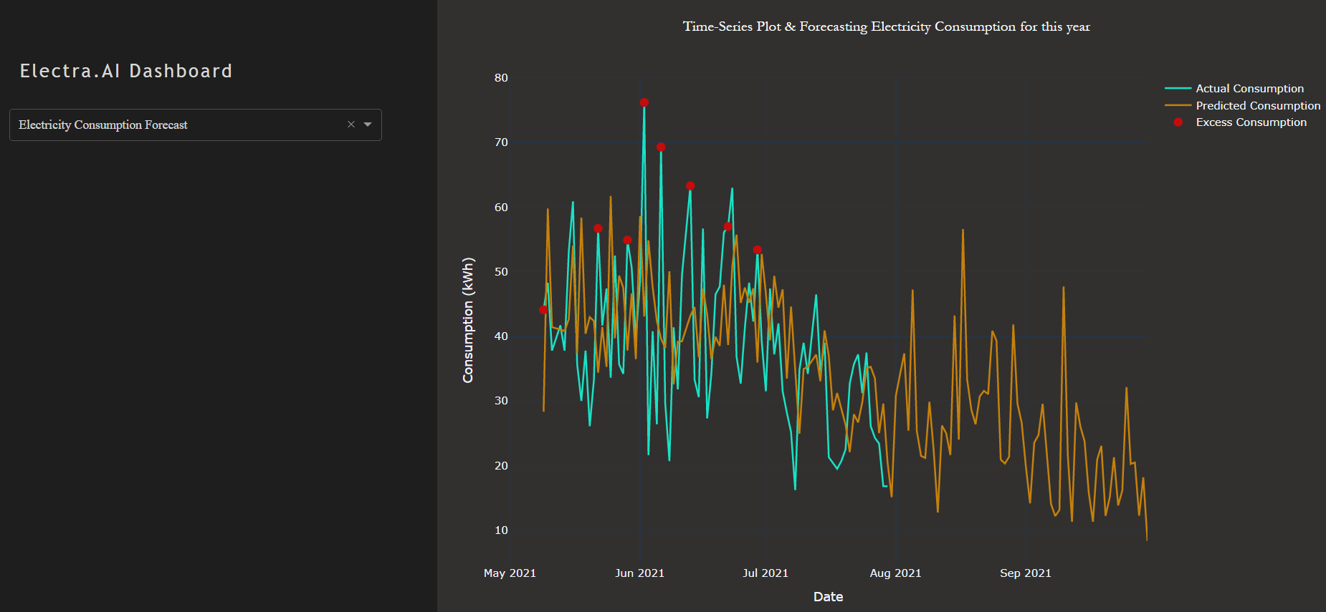
Electricity consumption forecast and early-warning alerts to keep it under control
Raising early warnings of the electricity consumption will help the user to be aware of the electricity bill and hence can work accordingly to minimize it. Automated emails along with the report is sent to the consumer
Automated Emails
Tracking of the days with excess electricity consumption

Slide 8

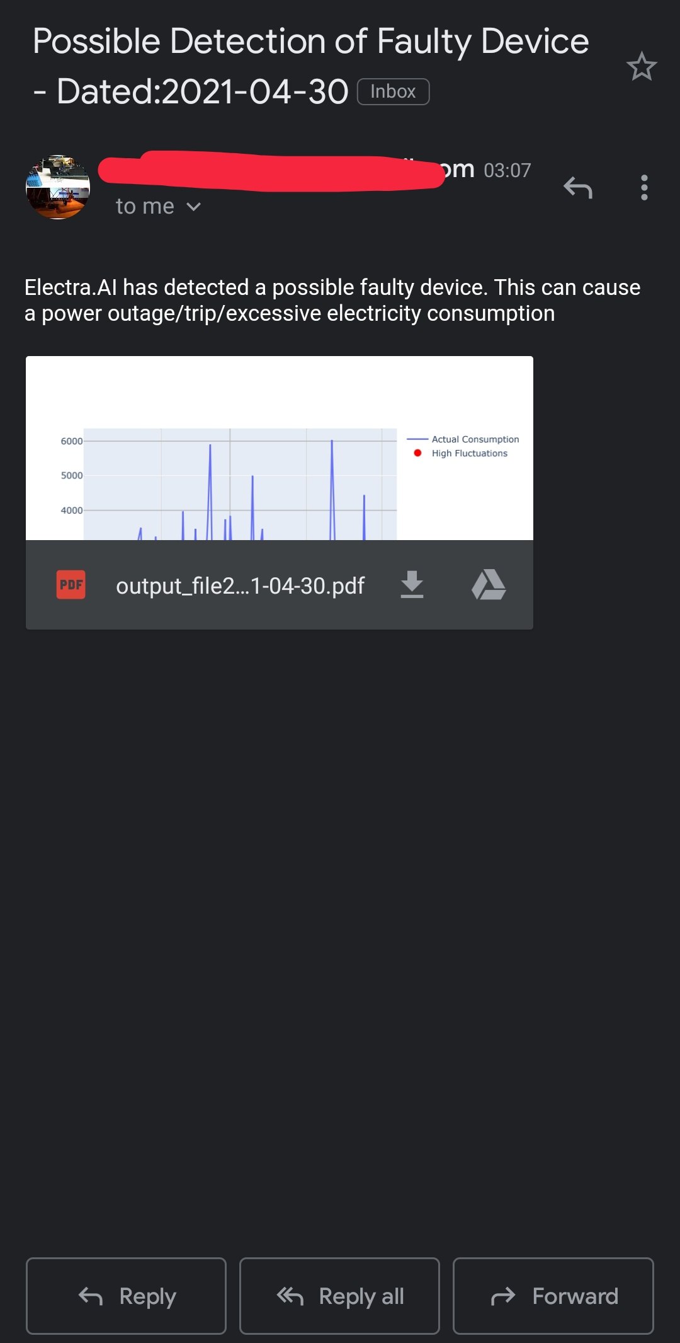
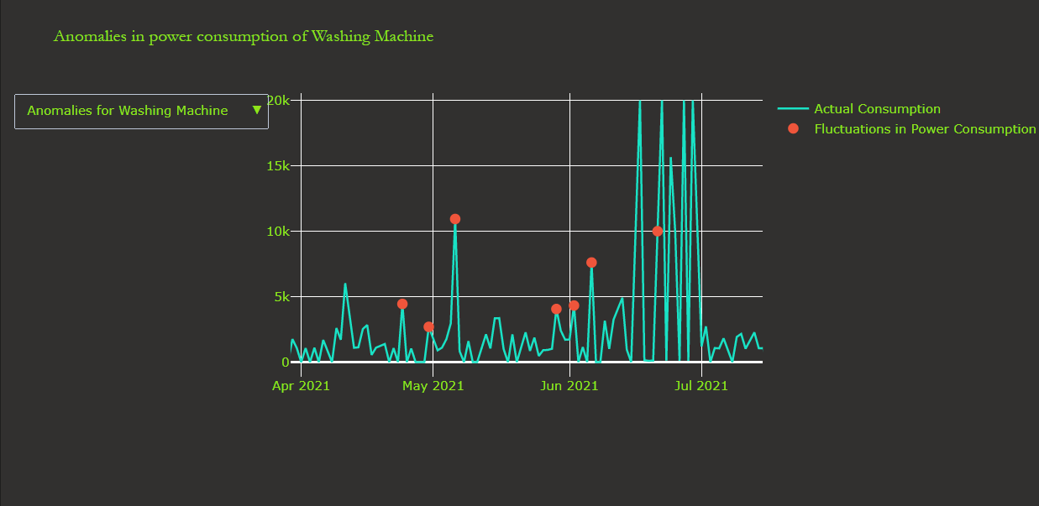
Detection of faulty devices through highly fluctuating power consumption
Automated Emails
Anomaly detection in power consumption of particular device can save a lot of power as well as prevent power outage
Anomaly Detection in Power Consumption of Washing Machine

Slide 9

Advantages of using Electra.AI
Cost Saving on Electricity Bill – Reduces the electricity bill by 8-15% on a monthly basis based on how religiously the consumer utilizes the data
Detection of Faulty Devices – Helps in detecting faulty devices, thus prevents excess electricity consumption, MCB trips, etc.
Environment Friendly - Helps to cut greenhouse emissions from electricity plants
Meter reading Margin of Error reduces to 0 – Manual intervention is not needed in meter reading so error is almost 0 unless technical glitch
Electricity Theft becomes impossible – Stealing electricity is a crime and because of this cloud storage, etc. it becomes easy to monitor consumption of energy
Improves Profitability of Power Company – Optimized power consumption by every household means less maintenance, less manual labor required
Power Saving & Efficiency – This will help in optimizing power consumption which will lead to less power outages/blackouts. This will also help in reducing the no. of plants
Detailed Electricity Report to Consumers – Offers homeowners detailed information about their power consumption so there won’t be any argument between the consumer and the supplier
Cost of Installation and Maintenance same as traditional meters – The installation and maintenance of a smart meter tends to be same as traditional meters. The research by UK Govt. showed that the cost of installation of a smart meter takes around GBP 100

Slide 10

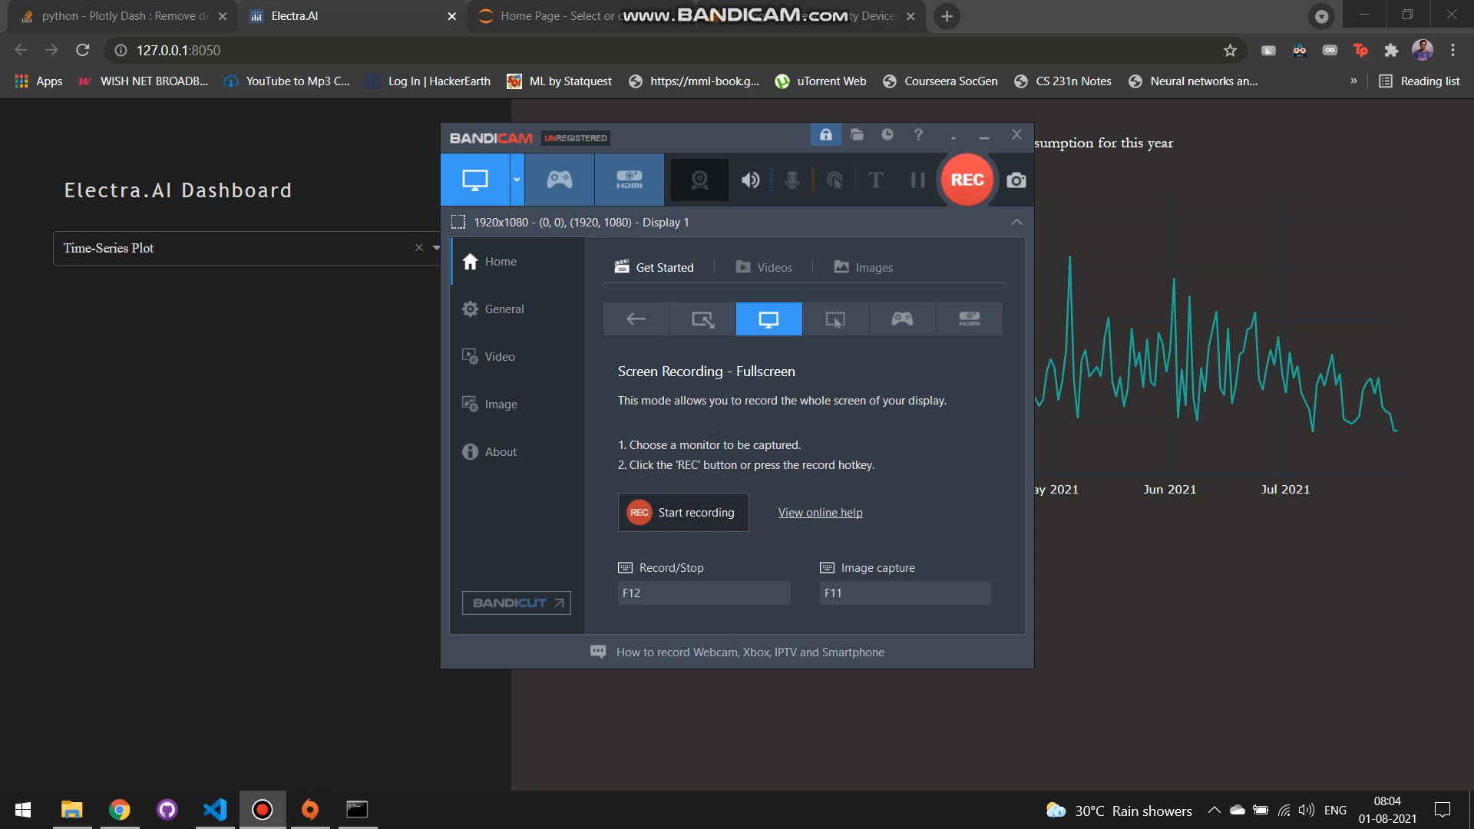
Demo Video

Slide 11
THANK YOU

